Slide 1
From Cloud to Storm
What causes an isolated storm?

Slide 2
Watching the Sky
What causes storms to form?

Slide 3


Looking back
What questions did we want to investigate on the Driving Question Board?
Notes:
Navigate from the previous lesson. Give students an opportunity to discuss where they left off in the Anchoring Phenomenon (Lesson 1). Remind students of their questions on the Driving Question Board and the need for further investigation of their questions.

Slide 4

Think about the water cycle
How do clouds form?
  Explain to your partner how water on the Earth’s surface might end up as a cloud in the atmosphere.
Notes:
Assess students’ prior knowledge about water cycling and phase changes during cloud formation. In pairs, have students explain to each other how water on the Earth’s surface might end up as a cloud in the atmosphere. Students may want to sketch a diagram on scratch paper or in their science notebook to help explain their thinking. Instruct students to focus on anywhere water is changing phase (e.g., from liquid to gas and back to a liquid). After explaining in pairs, hold a whole class share out to assess understanding. Provide direct instruction and vocabulary (e.g., water vapor, condensation) as needed.

Slide 5
Observations
Step 1: What can we learn about storms by watching clouds in the sky?
  Work in pairs or small groups, write down your ideas.
Notes:
Lesson 2: Step 1 of the Student Activity Sheet
Transition to the importance of making observations of the sky, specifically clouds. Direct students to the Lesson 2: Student Activity Sheet. Have students complete Lesson 2: Step 1 on the activity sheet with partners or in small groups. Students are prompted to think about the purpose for observing clouds and how observations are beneficial for understanding weather. Allow time for students to share why cloud observations, or other observations of the weather/ sky, can be useful.
Suggested prompts for discussion:
What can we learn about the weather by observing the sky over time?
What would we see if we watched the sky on a day when a storm was forming?
How could viewing a time-lapse video of the sky help us figure out more about clouds and storms?

Slide 6
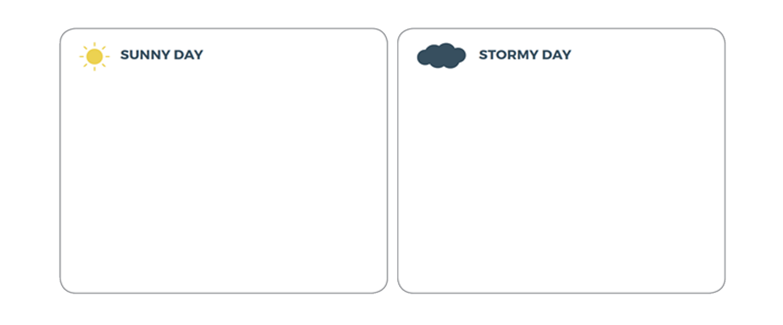
Sunny and stormy day time-lapse videos
Step 2: What did you notice about the sunny day compared to the stormy day?
  Observe the clouds in the time-lapse videos and record your observations.
These videos were captured on Eagle Ridge above Lyons, Colorado near the Front Range of the Rockies.
  Sunny Day Video Stormy Day Video
  April 6, 2017 July 4, 2017
Notes:
Lesson 2: Step 2 of the Student Activity Sheet
Make observations of sunny day and stormy day time-lapse videos. Introduce students to the time-lapse video context (see below). Play the sunny day time-lapse video. Have students make observations in Lesson 2: Step 2 of their activity sheets. As students observe, help them identify evidence from the video that indicates time of day. Next, play the stormy day time-lapse video and have students make observations on their activity sheets. Identify indicators for time of day—this is important for establishing that the morning begins clear, clouds appear, and the storm occurs in the afternoon.
SUNNY DAY AND STORMY DAY TIME-LAPSE VIDEOS
These videos were captured on Eagle Ridge above Lyons, Colorado near the Front Range of the Rockies by David Niels as part of his research for the Colorado Climate Center. The sunny day video was filmed on April 6, 2017. The stormy day video was filmed on July 4, 2017. Each video is two minutes in length.

Slide 7
Making sense
Why do you think that the storm formed on one day and not the other?
  Write down your ideas and be prepared to share with the class.
Notes:
Have students write their ideas and discuss the guiding question: “Why do you think that the storm formed on one day and not the other?” (Lesson 2: Step 2, continued) Prompt students to generate their initial ideas about what is different between the two days and if there is something causing the storm to form on the stormy day that is not present on the sunny day. (Note: While there are several factors related to the difference, the available moisture in the atmosphere is an important one.) Give students an opportunity to discuss their ideas in small groups, followed by whole group discussion.
This is your opportunity to informally assess what students already know about the relationship between storms and the water cycle. Below are examples of beginning and developing student ideas:
Beginning: The water vapor goes up in the air. There is more evaporation.
Developing: Evaporation was caused by heat. The heat and evaporation traveled up from the ground. The Sun’s energy warms the water and it evaporates and goes up to the clouds.
Record ideas to the Model Idea Tracker. Find a visible place in the classroom that will be used to record student ideas about how storms form (e.g., chart paper, PowerPoint, smart board, or whiteboard). This is the Model Idea Tracker, and it will be used repeatedly through GLOBE Weather. The tracker is a place to record consensus ideas that are helpful for explaining moisture in the atmosphere and precipitation. At this point in the lesson sequence, students may have inaccurate or incomplete ideas, which is important to be aware of moving forward. Do not record ideas to the Model Idea Tracker if the idea is not agreed upon.
Model Ideas:
Evaporation of water at the surface is important for clouds/storms.
Evaporation happens because of heating from sunlight.
Clouds form when water condenses.

Slide 8
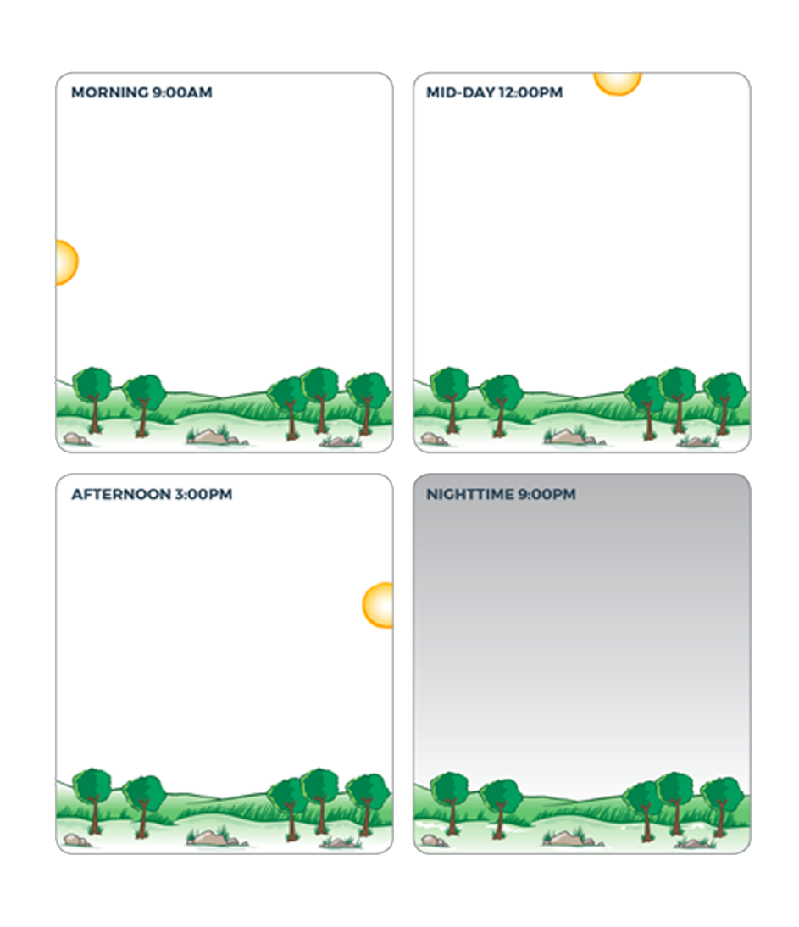
A thunderstorm story
Step 3: Draw how a storm forms throughout the day.
Draw what the weather is like at different times of the day.
Answer the questions and be prepared to share your ideas with the class.
Notes:
Lesson 2: Step 3 of the Student Activity Sheet
Tell the story of a thunderstorm forming throughout the school day. “Let’s imagine together a storm that might form throughout the day. You wake up to a blue sky. During the morning, a few small clouds appear. By lunch, there are more clouds, and they are much larger. By the end of the school day, it’s raining! The rain does not last all night, and by the time you go to sleep, stars are visible because the clouds are gone.”
Direct students to construct a time series diagram using Lesson 2: Step 3 on their activity sheets. The purpose of the time series diagram is to focus students on how storms change over time and what might be different at various moments over the course of a storm. The time series diagram is the first part of their Working Model for an Isolated Storm. They can revisit their diagrams throughout the learning sequence and especially as they work toward a Consensus Model later in this sequence. (Note: Students will not yet know the term “isolated storm” since this is the first type of storm that they are investigating in depth. The term is first used with students in Lesson 5, although you may wish to modify and add it earlier.)

Slide 9
Making sense
What is different in each stage of the storm and why?
Notes:
Share and discuss the diagrams. Prompt students to explain what is different in each stage of the storm and why they think there is a difference. As students share, use the following prompts to get them to think about measurements they may want to see to better understand the storms:
In the diagrams, we can see that the clouds are high above the ground. If you could somehow investigate the air up high compared to the air near the ground, what do you think you would see?
What are some measurements you would want to take of the air from different altitudes? How might those measurements help us figure out how clouds start to form on a sunny day?

Slide 10
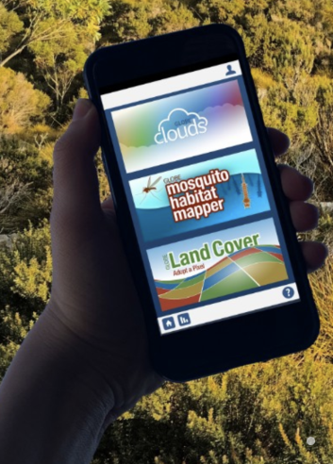
Learn about weather by watching the sky
Step 4: Make observations of clouds in the sky!
  Use the Cloud Chart or the
  GLOBE protocols to make
  cloud observations.
Notes:
Lesson 2: Step 4 of the Student Activity Sheet
Up until now, students have mostly discussed clouds and storms using video and images made by other people. Nothing can match the real experience of making observations outdoors. For Lesson 2: Step 4 choose either Option 1 or Option 2 below.
OPTION 1: Cloud Observations
Consider doing an outdoor cloud observation together as a class, identifying cloud types using the GLOBE Cloud Chart (globe.gov/globecloudchart). Then assign a project or home learning activity where students make a time-lapse video of clouds using their device and then make observations from their videos. Time-lapse videos are particularly powerful to see change over time and can be an engaging project for your students.
The following example questions can guide discussion around their videos and observations:
What did you notice happening to the clouds over time?
Did the clouds change shape or color?
Did you notice patterns in clouds at certain times of day?
OPTION 2: GLOBE Cloud Protocol
The GLOBE Cloud Protocol, in which students either use the GLOBE Observer Cloud app (observer. globe.gov) or the GLOBE Cloud Chart (globe.gov/globecloudchart) with the GLOBE Cloud Protocol (https://www.globe.gov/web/s-cool), are excellent ways to help students make in-depth observations of their environment. The required materials and time will vary depending on how you collect your observational data and use the data entry system. The Cloud Protocol is part of the Atmosphere Protocols (https://www.globe.gov/do-globe/globe-teachers-guide/atmosphere).

Slide 11
Temperature Clues
How does temperature relate to
cloud formation?

Slide 12
Looking back
If you could investigate the air up high compared to the air near the ground, what do you think you would see?
What are some measurements you would want to take of the air from different altitudes?
How might those measurements help us figure out how these clouds form?
Notes:
Navigate from the previous lesson. During the previous lesson, the following questions were posted and can be used to introduce this lesson:
In the diagrams (Lesson 2: Step 3), we can see that the clouds are high above the ground. If you could investigate the air up high compared to the air near the ground, what do you think you would see?
What are some measurements you would want to take of the air from different altitudes?
How might those measurements help us figure out how these clouds form?

Slide 13
Weather balloons
Weather balloons carry instruments into the atmosphere to collect temperature data at different altitudes––from near the ground to up where clouds form and even higher.
  Watch a video of a
  Weather balloon launch.
Notes:
Show a video of a weather balloon launch. The video shows how weather balloons are launched to take measurements in the atmosphere, and temperature is one of those important measurements.

Slide 14

Predict
Step 1: Use the temperature near the ground to predict the other temperatures.
How would temperature change as a weather balloon traveled from the ground to the clouds?
Where would it be warmer or cooler?
°C
°C
°C
21° C
Notes:
Lesson 3: Step 1 of the Student Activity Sheet
Make predictions of how temperature changes from the surface to altitudes where clouds form. Direct students to the Lesson 3: Student Activity Sheet. Read the instructions together. Tell students to imagine a weather balloon collecting temperature data as it goes up in the atmosphere. Ask students to make predictions about temperature from the ground to the height of clouds in Lesson 3: Step 1 and to share those predictions in small groups.

Slide 15
Investigation: Virtual Balloons
Step 2: Collect temperature data.
At a computer or tablet, open the Virtual Ballooning interactive. With this simulation you can launch virtual weather balloons and record the temperature at different altitudes in the atmosphere.
  Simulation: https://scied.ucar.edu/virtual-ballooning
Notes:
Lesson 3: Step 2 of the Student Activity Sheet
Arrange students in groups with computers or tablets for the Virtual Ballooning simulation. Explain to students that they will collect data from a simulation of weather balloon data. Orient students to the Virtual Ballooning simulation and discuss how they should collect and record temperature data in Lesson 3: Step 2, which prepares students for the simulation.
1. Click “Explore the Troposphere” to get into the game.
2. Get to know the graph. Notice that altitude is on the vertical axis (the y-axis) and temperature is on the horizontal axis (the x-axis).
3. Choose settings for a balloon launch. Each balloon you launch will make three measurements of temperature. Set the altitude to start recording the temperature by dragging the “Collect Data” arrow up or down the y-axis.
4. Click the “Launch Balloon” button and watch as your balloon collects temperature data.
5. Record that temperature in the table on the next page. Read the points that the balloon made on the graph to find the temperature at different altitudes.
6. Click the “New Flight” button and choose new settings for another balloon launch to collect more data. Collect as much data as you can with four balloon launches.
Lesson 3: Step 3 of the Student Activity Sheet
Students collect temperature data and record it on their activity sheet in Lesson 3: Step 2.

Slide 16
Making sense
Step 3: Analyze and interpret the data.
  Describe the pattern you see in the temperature data from the ground to where storm clouds form.
  Is this the pattern you predicted? Why or why not?
  What do you think is causing the temperature pattern?
  How does the temperature pattern relate to isolated storms forming? (Draw or write your ideas)
Notes:
Students work with peers to analyze the data (Lesson 3: Step 3, Questions 1 and 2) and interpret the data (Lesson 3: Step 3, Questions 3 and 4). Conduct a class discussion focusing on students’ ideas about these questions and working toward the key pattern:
KEY PATTERN: Temperature is warmer near Earth’s surface and temperature decreases as the weather balloon moves higher into the atmosphere where clouds/storms form. (Note: This pattern holds true in the troposphere.)
As students discuss this pattern, elicit other first-hand or second-hand experiences they’ve had related to Earth’s warmer air temperatures at lower altitudes and the air being cooler higher in altitude/elevation. Probe students’ initial ideas about why this pattern might occur.
Discuss the final question: How does temperature relate to clouds as an isolated storm forms? Encourage students to use what they figured out about temperature and altitude to reconsider what might be happening in the Anchoring Phenomenon or storm formation in general. Students can discuss specific storms at this time or more general patterns they notice about temperature and storms.

Slide 17
Next steps
If we were able to look closely at different altitudes, from near the surface to high in the sky, what temperature pattern would you expect to see?
How do you think the results would compare if we measured temperature throughout a school day?
Notes:
Transition to the next activity. Use the following questions to get students thinking more about temperatures near the surface of Earth:
If we were able to look closely at different altitudes, from near the surface to high in the sky, what temperature pattern would you expect to see?
How do you think the results would compare if we measured temperature throughout a school day?

Slide 18
Looking back
Explain what we observed in the Virtual Ballooning investigation that helps answer these questions:
  If we zoomed in to this part of the altitude where we live, what temperature pattern would you expect to see?
  How do you think the results would compare if we measured temperature across a school day?
Notes:
Planning note: If you want students to focus only on data analysis, you can use the data set provided in the activity below. If you’d like students to collect their own data, have students collect air temperature and surface temperature data following GLOBE Atmosphere protocols (globe.gov/do-globe/ globe-teachers-guide/atmosphere) and replace Lesson 3: Step 4 on the activity sheet with your students’ data.
DATA ANALYSIS ONLY OPTION
Navigate from the previous activity. Have students explain the temperature patterns they observed in the Virtual Ballooning investigation. Remind students of questions at the end of the last activity in order to set a purpose for analysis of the next data set:
If we zoomed in to this part of the altitude where we live, what temperature pattern would you expect to see?
How do you think the results would compare if we measured temperature throughout a school day?
** If doing the GLOBE Surface Temperature and Air Temperature protocols, introduce the protocols here. Students do not need to complete the data analysis on the Longmont Data Set below because they can analyze their own data set.**

Slide 19
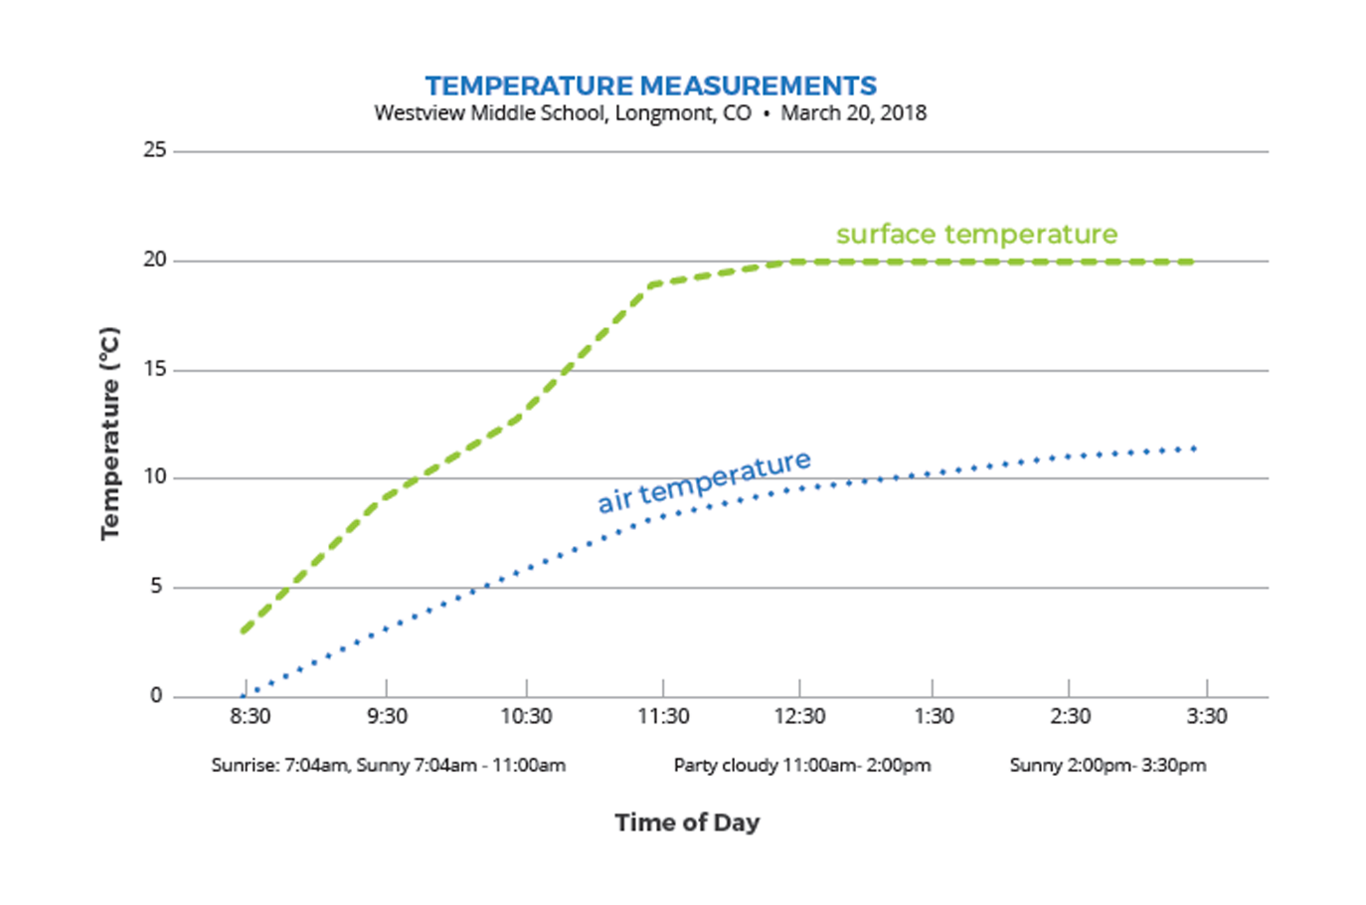
Investigation: Westview Middle School Data
Notes:
**If doing the GLOBE Surface Temperature and Air Temperature protocols, introduce the protocols here and skip this slide.
Introduce students to the data set. Describe where the air temperature and surface temperature data was collected, over what time period, and how it was collected. (See description below.)
LONGMONT DATA SET
Middle school students in Longmont, Colorado wanted to know how the ground temperature (surface temperature) compared to air temperature. They measured both temperatures over a school day. Their surface temperature data were measured on their school track and their air temperature thermometer was located on the school roof. The students agreed these two surfaces were the most similar, which is why they selected the school track for their surface temperature location. They measured both temperatures every hour during the school day. They also made observations of cloud cover.
Use the Identify and Interpret (I²) Sensemaking Strategy to analyze and interpret the graphed data. Orient students to the graph in terms of the axes, the data lines showing surface and air temperature data, and the cloud cover notes.
*Directions for using the I² strategy are on the next slide.

Slide 20

Identify and Interpret (I²) Sensemaking Strategy
Step 4: How do air and surface temperature change during a day?
Use the I² Sensemaking Strategy to analyze the Westview Data Set.
Do you notice patterns or any interesting differences?
Explain what you think is happening in each part of the graph.
Write What I See statements on the graph to share your observations.
Next to each What I See statement, write What it Means statements.
Notes:
Use the Identify and Interpret (I²) Sensemaking Strategy to analyze and interpret the graphed data.
a. Write “What I See” statements. To do this, students write observations of the data in the graph. Students draw the “What I See” icon followed by their observation (e.g., “The surface temp line on the graph is always above the air temp line”). Students also draw an arrow to the part of the graph that corresponds to their observation. Remind students to avoid “because” statements and focus on observations only. Conduct a short discussion highlighting where students have similar or different observations.
b. Write “What It Means” statements. To the side of each “What I See” statement (observation) students draw the “What It Means” icon and then an explanation (e.g., “The surface is warmer than the air”). Each What I See statement should have a What It Means statement next to it. These statements are students’ interpretations of what is happening in each part of the graph. Conduct a discussion about students’ ideas. Because students are still exploring, it is okay for them to have incomplete explanations. Focus on accurate observations and logical, even if incomplete, explanations.

Slide 21
Conclusion
What did you figure out by investigating the Longmont Data and Virtual Balloons?
  Share these ideas and record them in the Model Idea Tracker.
Notes:
Ask students to share what they learned from the surface temperature and air temperature analysis. Have students reflect on how the Virtual Ballooning data and the Longmont Data Set have informed their thinking. One important finding is that the surface is warmer than the air above it but that the two temperatures mirror each other as the Sun heats the Earth. Add this idea to the Model Idea Tracker.
Model Ideas:
The surface is warmer than the air above it.
The air near the ground is warmer than air closer to where clouds form.

Slide 22
Make a model
Step 5: Make a model of how sunlight warms the atmosphere.
Your model should explain:
  How surface temperature is related to the sunlight
  How air temperature is related to surface temperature
  How the air temperature changes from the ground to higher altitudes
  How you know the above three things using evidence from temperature data
Notes:
Lesson 3: Step 5 of the Student Activity Sheet
Introduce the Working Model for explaining temperature patterns. In Lesson 3: Step 5, students will develop a Working Model of surface heating to explain temperature patterns, with the ground surface having the warmest temperatures and temperature decreasing with altitude. This is a Working Model because it’s a work in progress and does not capture a complete representation of the system, only part of the system.
Draw and label a Working Model individually. Before students begin their model, preview the items listed on Lesson 3: Step 5 of their student activity sheets to provide guidance about what their models need to explain and the question their models are trying to answer: “Why does the surface temperature warm over the day, and why is the surface warmer than the air above it?” Their models should describe connections between sunlight heating Earth’s surface and the temperature pattern they’ve observed, particularly why the surface is warmer than the air above it, which leads into the next lesson on warm air rising. These models will vary in sophistication based on prior learning of particle models, temperature, and thermal energy transfer.

Slide 23
Revise your model
Share your model with your group.
Ask clarifying questions of each other.
Revise your own model based on feedback from your group.
Notes:
Share and revise Working Models in small groups. Arrange students in small groups to share their models. Students should revise their models based on feedback from their group.
Discuss Working Models in whole group discussion. Have students share how they represented different parts of the model and allow the students time to debate how they want to represent those parts as a class. Students can make edits to their models as the class discusses these models. As students discuss their thinking, check the Model Idea Tracker to add to the tracker or update the Model Ideas.
Suggested prompts for discussion:
Why do we think surface temperature is warmer than the air temperature above it?
How is the warm air moving? Does this match our temperature pattern?
More advanced question for students with prior knowledge on particles and temperature: What’s happening to the air molecules when they are heated near the surface?

Slide 24
Making sense
Step 6: How does your model relate to storms?
There wasn’t a storm on the day when Westview Middle School collected surface temperature and air temperature data, but it did get cloudy in the afternoon.
  How do you think temperature relates to the clouds forming?
  What evidence from your model supports your answer?
Notes:
Lesson 3: Step 6 of the Student Activity Sheet
Connect the Working Model to an isolated storm. In Lesson 3: Step 6, have students discuss their ideas about how the temperature patterns relate to the formation of clouds and storms. In particular, have students think about why these types of storms tend to happen in the afternoon, after the Sun has been up for hours.

Slide 25
Fuel for Storms
What is different about a sunny day and a stormy day?

Slide 26
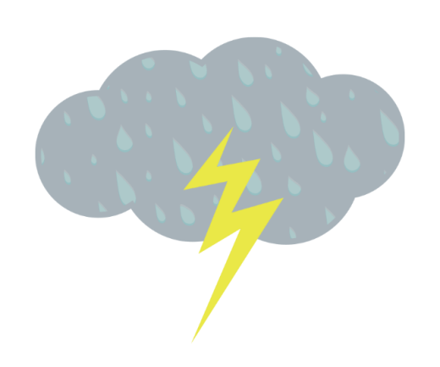
Looking back
How does temperature relate to clouds and isolated storms forming?
Notes:
Navigate from the previous activity. At the end of the previous activity, students discussed how temperature could be related to storms forming. Have students review their ideas before beginning the next activity.

Slide 27
Looking forward: Brainstorm
How can one day be warm and sunny, while the next day is still warm but with an isolated storm? What is different about the two days?
What weather measurements might help to answer these questions?
Notes:
Brainstorm ideas about a sunny day vs. a stormy day. Get students thinking about data comparisons between a sunny day and a stormy day.
Pose the following questions:
How can one day be warm and sunny, while the next day is still warm but with an isolated storm?
What is different about the two days?
What weather measurements might help to answer these questions?

Slide 28
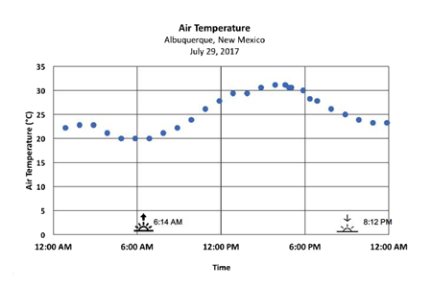
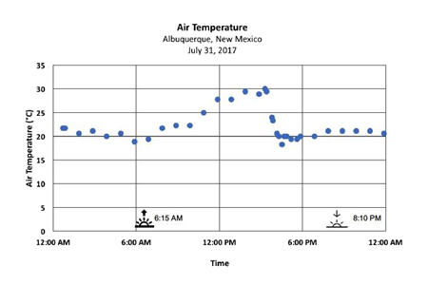
Investigation: Sunny Day and Stormy Day
Step 1: Compare air temperatures on a sunny day and a stormy day.
Sunny Day Stormy Day
Notes:
Lesson 4: Step 1 of the Student Activity Sheet
Orient students to the sunny day and stormy day data. Direct students’ attention to Lesson 4: Step 1 of their student activity sheets. Students will compare air temperature on a stormy day and a sunny day. You can use the I² Sensemaking Strategy, or another graph interpretation strategy, for this activity.
SUNNY DAY AND STORMY DAY DATA
The temperature and (relative) humidity data set comes from a local automated weather station in Albuquerque, New Mexico. The data can be found online through Weather Underground and the U.S. National Weather Service. The July 29, 2017 plot is from a sunny day, while it was a stormy day on July 31, 2017.
Analyze the sunny day and stormy day data. Give students time to analyze and interpret the graphs in partners or small groups. Encourage students to write on the graphs using WIS and WIM statements if using the I² Sensemaking Strategy.
Identify air temperature patterns. Ask students to describe the sunny day and stormy day temperature patterns. Ask students to share and compare the patterns they observed in the air temperature graphs. The following two patterns should emerge from these discussions:
Sunny pattern: Temperature gradually warms and then gradually cools on a sunny day
Stormy pattern: Temperature gradually warms but then quickly cools in the afternoon
Have students circle on their stormy day graph when they think it rained. Ask students to write an explanation about their choice and share their ideas with their group. Prompt several students to share their ideas aloud during whole group discussion. Encourage students to explain what they see in the temperature data that indicates a storm.

Slide 29
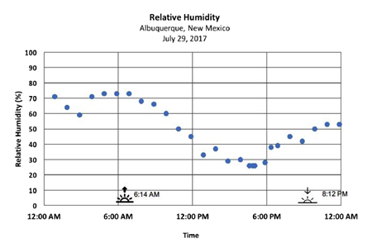
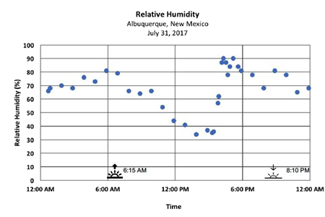
Investigation: Sunny Day and Stormy Day
Step 2: Compare the humidity on a sunny day and a stormy day.
*Humidity is the amount of water vapor in the air
Sunny day Stormy day
Notes:
Lesson 4: Step 2 of the Student Activity Sheet
Identify humidity patterns. Direct students to Lesson 4: Step 2, which is the second set of graphs showing humidity over the same times. Tell students that humidity is a way to measure the amount of water vapor, or moisture, in the air. Use the I² Sensemaking Strategy to help students analyze and interpret the humidity graphs. Ask students to describe the sunny day and stormy day humidity patterns. Ask students to share and compare the patterns they observed in the humidity graphs.
The following two patterns should emerge from these discussions:
Sunny pattern: Humidity begins high but goes down during the day
Stormy pattern: Humidity begins high and starts to go down, then it climbs really high, really quickly in the afternoon/early evening
Have students circle when it rained on their stormy day humidity graph. Ask students to write an explanation about their choices and share their ideas with their group.

Slide 30
Making sense
When did the rain happen?
  What were the temperature and humidity conditions that led to the rain event?
  Describe the temperature and humidity before, during, and after the storm.
Notes:
Compare air temperature and humidity for a stormy day. Using both data sets, when does the class think it rained? What were the temperature and humidity conditions that led to this event? Have students articulate what the temperature and humidity was like before, during, and after the storm through a whole class discussion.

Slide 31
Conclusion
What discoveries did your class make about the stormy day?
  Share these ideas and record them in the Model Idea Tracker.
Notes:
Add new ideas to the Model Idea Tracker.
Have students generate new ideas about the stormy day using the air temperature and humidity patterns. Record these on the Model Idea Tracker.
Model Ideas:
Rising temperature and humidity are good conditions for an isolated storm.
Rising temperature and low humidity are not good conditions for an isolated storm.

Slide 32
Next steps
If we created a system with warm temperatures and lots of moisture, it would rain. But if we didn’t have warm temperatures or enough moisture, do you think it would rain or not?
  Next we will try it out and see what happens.
Notes:
End the discussion transitioning to the next activity on bottle models.
“If we created a system with warm temperatures and lots of moisture, it would rain, but if we didn’t have warm temperatures or enough moisture, do you think it would rain or not? Let’s see if we can try this out.”

Slide 33
Looking back
What did we figure out about temperature and humidity patterns for a sunny day compared to a stormy day?
  Discuss with a partner
Notes:
Planning note: The Bottle Model activity can be completed as a lab or a demonstration. There is also a time-lapse video that can be used if time and materials do not allow for a lab or demonstration. Make the necessary modifications to meet your students’ needs based on your available equipment. The purpose of this demonstration is to help students connect the data measurements they just analyzed with visual evidence they can see. The instructions below are written for a class demonstration. See the following page for a description of the demonstration set-up.
Navigate from the previous lesson.
Have students describe the temperature and humidity patterns for a sunny day and stormy day and the need to test these conditions to see if they can create “storms” and “no storms” in a small system.

Slide 34
Looking forward: Brainstorm
How could we test different temperature and humidity conditions to create a ”sunny day” and a “stormy day” in a bottle?
  What materials could we use?
  What could we put in each bottle to create one with a “sunny day” and one with a “stormy day”?
Notes:
Use temperature and humidity patterns to brainstorm how to build a storm in a bottle. Ask students to use what they have learned about temperature and humidity to make a storm in a bottle. Provide students with a general idea of how to set-up the experiment and a list of possible materials, but allow students to brainstorm what they would add to a bottle to form a storm versus what they would add so as not to form a storm.
As a class, decide on two systems, one “sunny day” (no storm) bottle; one “stormy day” (storm) bottle, to test. Ask student volunteers to help insert the necessary materials into the bottles using a funnel. For wet sand/dirt, insert the dry sand or dirt first, then add water.

Slide 35
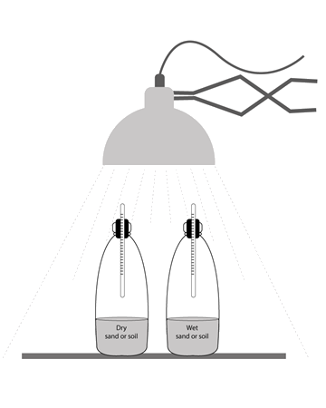
Investigation: Storm in a Bottle
Step 3: Make a storm in a bottle.
Using what you know about temperature and relative humidity, create a model of a sunny day and stormy day using clear bottles with different contents.
Draw what you put inside each of your bottles. Label the materials that you added.
Notes:
Lesson 4: Step 3 of the Student Activity Sheet
See the Lesson 4 Teacher Guide for instructions about the Bottle Model Demonstration
Bottle Model Time-lapse Video: https://scied.ucar.edu/bottle-model-timelapse
Diagram the lab set-up. Direct students to Lesson 4: Step 3 to draw the lab set-up and to label the parts of each system and what those parts represent.

Slide 36
Review:
Water evaporates from the ground as water vapor when it is heated by the Sun.
Water vapor condenses back into water droplets in the sky, forming clouds.
Water falls to the ground as precipitation when the air cannot hold any more water (100% humidity).
Notes:
Review the steps of the water cycle as needed.
Discuss, as a whole group, students’ predictions about which conditions will lead to the best storm and why (and vice versa). Specifically, talk about what we expect to see if we have created conditions for a storm to form (e.g., Will it actually “rain” inside the bottle? What might we see?). Remind students that water vapor isn’t visible and review the parts of the water cycle this activity will demonstrate (focus on evaporation and condensation). Look at the data table (Lesson 4: Step 3) and point out that temperature should be measured every 2 minutes. Decide as a class what will be recorded in the humidity column of that data table (e.g., Will students record when condensation is visible vs. not visible?).

Slide 37
Investigation: Storm in a Bottle
Step 3 (continued): Turn on the lamp to represent the Sun and observe the bottles for 20 minutes.
  Add your observations about temperature and humidity for each bottle to the pictures.
  Use the data table to record temperature and humidity changes in your bottles.
Notes:
Turn on the lamp and let the demonstration run for at least 15-20 minutes. The higher the watt bulb used, the quicker your students will see results. You can run this lab as long as you need to see a temperature change and condensation.
Make observations of the bottles. Have students make observations of the bottles and record temperature measurements in a data table (Lesson 4: Step 3). Use a clock or timer to keep track of the time and have students record observations every 2 minutes.

Slide 38
Making sense
Did the sunny day bottle match what you expected? If not, what happened?
Did the stormy day bottle match what you expected? If not, what happened?
Using evidence from the bottles and the temperature and humidity data, what conditions are best for storms?
Notes:
Discuss and compare results. Give students an opportunity to discuss the questions on their activity sheets in small groups or using a collaborative group strategy.
Discussion questions:
How did the sunny day bottle match/not match what you expected?
How did the stormy day bottle match/not match what you expected?
Changing the amount of water in the system (humidity/moisture) was important. If a town is located far from an ocean or large body of water, where does the water come from?
Using evidence from the bottle models and the temperature and humidity data in Lesson 4: Step 1 and Step 2, what conditions are best for storms?
Transition to whole group discussion. Specifically focus on the importance of the source of water and the best conditions for a storm. In the water only condition, the source of water might represent large bodies of water or the ocean. In the damp soil/sand condition, the source of water represents groundwater and smaller surface water sources. Prompt students to connect their observations back to the temperature and humidity patterns observed for a sunny and stormy day.

Slide 39
Conclusion
What discoveries did your class make from the Storm in a Bottle investigation?
  Share these ideas and record them in the Model Idea Tracker.
Notes:
Add to the Model Idea Tracker as students come to agree upon the role of moisture.
Model Idea:
A source of moisture is important to get water into the atmosphere for storms.

Slide 40

Next steps
How did the water from the bottom of the bottle get up on the sides of the bottle?
Notes:
Look ahead to the next lesson.
End the discussion, posing the question: “How did the water from the bottom of the bottle get up on the sides of the bottle?” Have students share their initial responses to this question.

Slide 41
Air on the Move
How does air move and change
when a storm is forming?

Slide 42
Looking back
What happened to the water at the surface before it traveled to the top of the bottle?
What happened to the water at the top of the bottle?
How did that water get up there? Why would it go up?
Notes:
Navigate from the previous lesson.
At the end of the previous lesson, students shared their ideas about how water at the surface (near the bottom) of their bottles got onto the upper part of the bottle.
Review this discussion using the following question prompts:
What happened to the water at the surface before it traveled to the top of the bottle?
What happened to the water at the top of the bottle?
How did that water get up there? Why would it go up?
Motivate the need to investigate vertical movement of air. Students may say evaporation is how water at the surface gets higher in the atmosphere. Remind students about the water cycle. Talk about what evaporation means and how it explains the change of liquid water to gas but not how it travels upward. (Consider whether students need additional support to understand processes of the water cycle.)
Suggested transition: “So we know the surface is warmed here and water evaporates, and we know water condenses up here because it’s cooler, but how and why does the water vapor travel up? We need to figure this out. If we add heat to air down here, can we get the balloon to travel up?”

Slide 43
Looking forward
How and why does the water vapor travel up?
What prior experiences do you have with warmed air or warmed water vapor that might help us explain this?
Notes:
Elicit student experiences of warmed air and steam.
Ask students to think about why recently warmed water vapor would travel up. Broaden the discussion to elicit students’ experiences of warmed water vapor (e.g., steam) and warmed air (e.g., “heat waves” off highways). Point out a pattern that this warm air seems to move up. Ask students why they think warm air moves upward.

Slide 44
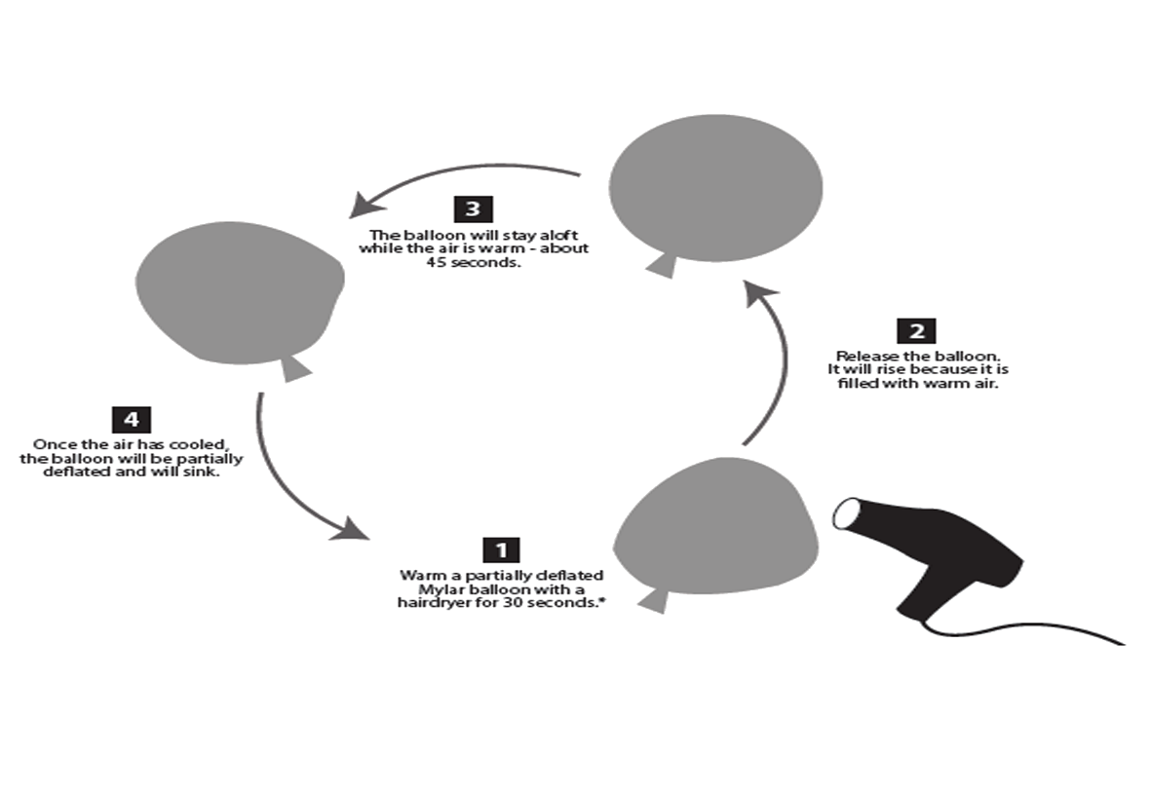
Investigation: Mylar Balloon
Step 1: Observe warmed and cooled air.
Draw the set-up
Record observations as the balloon is warmed and as it cools down
Demonstration video: https://scied.ucar.edu/warming-mylar-balloon
Notes:
Lesson 5: Step 1 of the Student Activity Sheet
See the Lesson 5 Teacher Guide for instructions for the Mylar Balloon Demonstration.
The video can be viewed if you will not be doing the demonstration with your students.
Introduce students to the Mylar balloon investigation. The Mylar balloon contains helium gas, and students are going to heat the gas to see if they can get the balloon to move upward.
Draw the lab set-up. Direct students to Lesson 5: Step 1 of their student activity sheets. Ask students to draw the demonstration set-up on their activity sheets.
Warm the Mylar balloon. Have a student volunteer to warm the Mylar balloon using a hair dryer. It is important to represent the balloon as a pocket of air located at the surface of Earth. The hair dryer should represent thermal energy radiated from the ground and not light energy from the Sun above.
Make observations of the balloon. Students make observations of what they see and hear happening to the Mylar balloon as the air inside is warmed (e.g., crinkling as it expands and travels up to the ceiling). Prompt students to add these observations to their observation sheet in Lesson 5: Step 1. Continue observing the Mylar balloon as it cools (roughly one minute or less). Once the air inside the balloon cools, it begins to sink and visibly shrink. Prompt students to add observations to their observation sheets. Repeat the demonstration a second or third time with different student volunteers to make additional observations and to prompt students to start explaining what’s happening in the balloon.

Slide 45
Making sense
Why does the heated balloon go up? Think about what is happening inside the balloon.
What is happening inside the balloon when the balloon starts to sink?
Notes:
Develop an initial explanation. Direct students to the questions at the end of Lesson 5: Step 1 on their activity sheets. Students are prompted to explain what is happening inside the Mylar balloon as it is heated and when the balloon sinks. If students are new to particle motion and thermal energy, they may be more uncertain about what’s happening in the balloon. You are steering them toward a basic understanding that warmed air molecules move more and are more spread apart, and vice versa for air molecules that have cooled. Students will encounter these concepts in the reading that follows. Encourage students to think about the balloon having the same amount of air, whether warm or cool, but changing in terms of volume, which they see when the balloon expands and contracts.

Slide 46
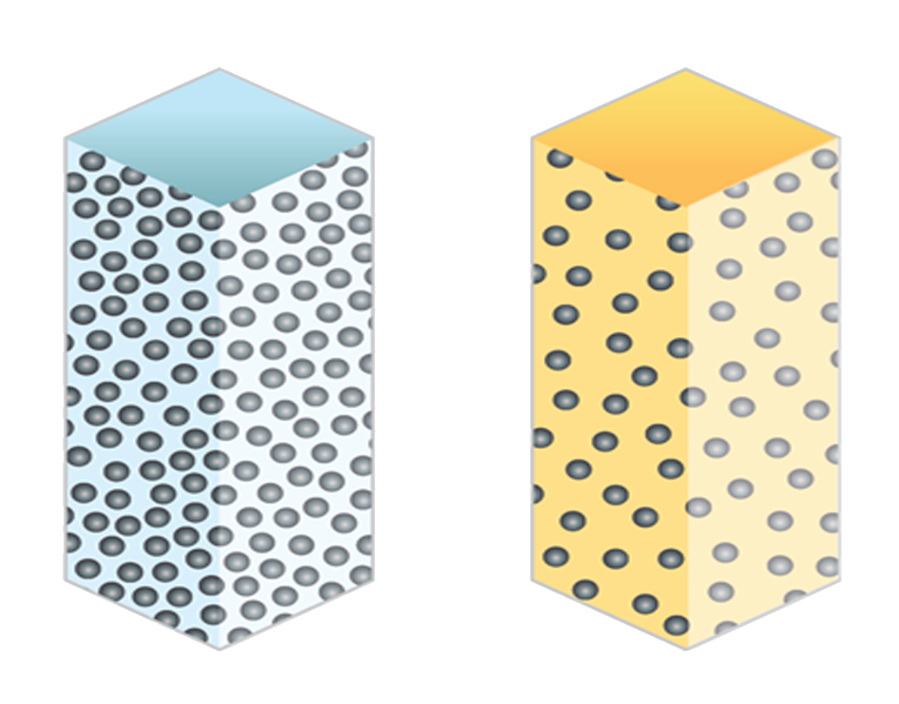
Interactive Reading
Step 2: Air on the Move
Read about the differences between cold and warm air.
Draw a diagram of 20 air molecules inside the mylar balloon when they are warmed and when they are cooler.
Cold Air
Warm Air
Notes:
Lesson 5: Step 2 of the Student Activity Sheet
Navigate from the Mylar balloon investigation. Students have initial ideas explaining the warm air inside the balloon traveling up. They likely need more information to put together the pieces of a convection model. Explain to students that reading more about the molecules in the air can help them figure out more of what’s going on. Direct students to Lesson: 5, Step 2, an interactive reading called Air on the Move. Students will interact with the new information by drawing diagrams and summarizing new information.
Read the first two paragraphs and diagram warm and cool air. The first part of the reading focuses on what happens when heat transfers to air molecules or when those molecules lose energy. Students draw diagrams to show warmed air molecules in a balloon moving faster and spread apart and cooler air molecules closer together and moving slower.

Slide 47
Interactive Reading
Step 2: Air on the Move
Read about how gravity affects air molecules.
Draw air molecules between the planet and the top of the atmosphere.
Notes:
Lesson 5: Step 2 of the Student Activity Sheet
Read about how gravity affects air molecules. Students read and draw air molecules low in the atmosphere at higher pressure and high in the atmosphere at lower pressure (more spread out), which will help them understand why warm air rises. Have students label where “low pressure” and “high pressure” are on their drawings.

Slide 48
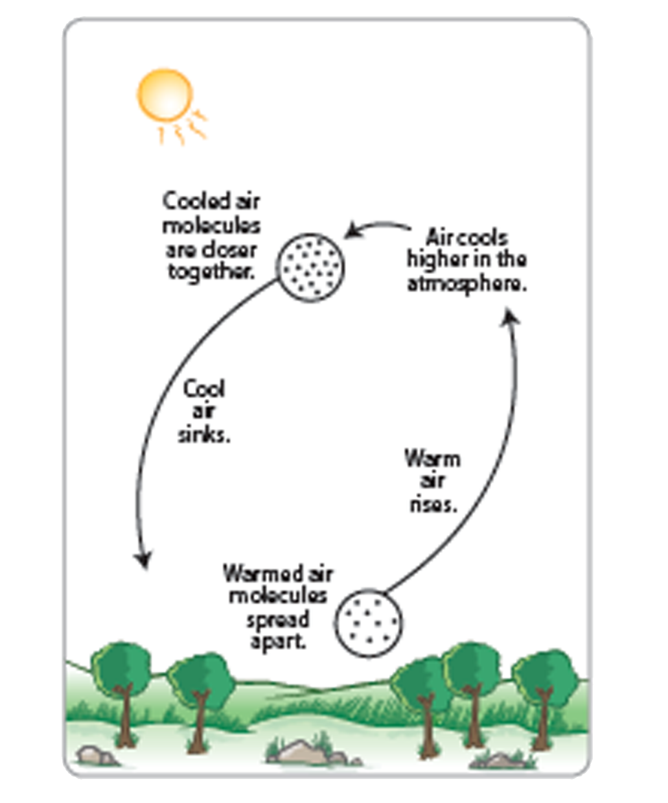
Interactive Reading
Step 2 continued: Air on the Move
Read about convection.
Write an explanation for why warm air goes up and cold air goes down.
Notes:
Lesson 5: Step 2 of the Student Activity Sheet
Read about convection. Students read and draw a particle diagram showing how air molecules change during convection. After diagramming the molecules, pose the question: “How could convection be related to _______?” (e.g., the Mylar balloon, the bottle models, storms forming). Students are reminded about the relationship between water vapor and warm/cooled air (from Lesson 4). The vapor condenses from the air when the air reaches cooler temperatures.

Slide 49
Conclusion
Why does warm air go up and cool air go down?
  Reflect on the reading as well as information from other activities we have done so far.
  Share these ideas and record them in the Model Idea Tracker.
Notes:
Revisit explanations of warm air rising and add to the Model Idea Tracker. Conclude the reading, reflecting on the question: “Why does warm air go up and cool air go down?” Students write their ideas on the reading first. As students share their thinking with the class, prompt students to connect to the previous phenomenon or data patterns they have seen in the unit (e.g., Mylar balloon, bottle models, isolated storm time-lapse videos, temperature patterns from the surface to the clouds) and how the new concepts help them explain what they observed.
Model Ideas:
Warm air rises and cooler air sinks.
Warm air is able to take in more water vapor compared to cool air.

Slide 50
Taking stock
The Driving Question Board
  What questions can we now answer? What connections can you make?
Notes:
Devote time to “taking stock” by returning to the Driving Question Board. As you navigate from the reading and students’ recently developed ideas about air molecules, particle motion, and convection, have students reflect on what they have learned. Return to the Driving Question Board to see which questions students can now answer. As students review their questions and develop answers to some of those questions, use this information to inform how you approach the Consensus Model. It might be the case that students need to revisit a particular data set from earlier in the sequence to “refresh” their thinking and/or to make connections they have not made yet.

Slide 51
Making sense
What causes an isolated storm to form?
  Revisit the stormy day time-lapse video (Stormy Day Video: July 4, 2017)
  In groups, discuss the important things that happened for the storm to form.
  What ideas from our Model Idea Tracker might help us explain what causes an isolated storm?
Notes:
Revisit the stormy day time-lapse video to motivate explanation of this phenomenon.
Replay the isolated storm time-lapse video, and have students work in small groups to discuss important things happening for the storm to form. Tell students they are going to develop a model to explain the isolated storm: “Let’s see if we can put together all the things we’ve learned to create a model that explains what’s happening for the storm to form.”
Revisit the Model Idea Tracker.
Use the Model Idea Tracker to review important “rules of the system”. These Model Ideas have evidence to support them and can help students make sense of how a system works. As students construct the Consensus Model, they should pay attention that their Consensus Model is consistent with their Model Ideas.

Slide 52
Make a model
Step 3: Create a model to describe how precipitation happens in an isolated storm.
Draw and write in the illustration. Make sure your model explains:
What happens to energy from the Sun that leads to the isolated storm?
What happens to water at the surface and clouds that lead to the isolated storm?
How do air temperature and humidity change as air moves from the ground to the cloud?
How does air move between the ground to where the storm forms?
Notes:
Lesson 5: Step 3 of the Student Activity Sheet
Prepare for the Consensus Model. Direct students to Lesson 5: Step 3 on their student activity sheets to record their ideas individually about how precipitation happens in an isolated storm. Tell students that after they develop their model, the class will construct a Consensus Model for an Isolated Storm that takes student model ideas into account.

Slide 53
Develop a Consensus Model
  Use ideas from student models to draw a Consensus Model for the class to show what has to happen for an isolated storm to form.
  Use data or other evidence from our investigations to support the ideas added to the Consensus Model.
  Revise your student models to represent the class’ ideas in a way that makes sense to you. Use a different color pencil as you revise your model from Step 3.
  Write your own explanation that goes with the model in Step 3.
Notes:
Develop a Consensus Model. In a public space, draw the Consensus Model for an Isolated Storm as students share their thinking about important processes and conditions for storms. For each suggested addition, put the idea forth to the class for other students to clarify and add to before it is recorded on the class model. Specifically ask students to cite data or other evidence to support their ideas. A list of guiding questions is provided on the student activity sheet to help organize parts of the model.
Record the Consensus Model. After the class version of the Consensus Model for an Isolated Storm is complete, direct students to revise their models on their student activity sheets using a different color of pencil. Encourage students to represent their thinking in different ways if it helps them make sense of what’s happening in the model. They do not need to record the exact model constructed by the class, but they do need to record one that is consistent with the Model Idea Tracker.

Slide 54
Making a Thunderstorm
Can we identify the best conditions for storms?

Slide 55
Driving Question Board
What questions can we answer now?
Notes:
Navigate from the previous lesson.
Take a moment to review the Consensus Model. Ask students if there are new questions from the Driving Question Board that they can now answer. Have students share these questions and answers with the class.

Slide 56
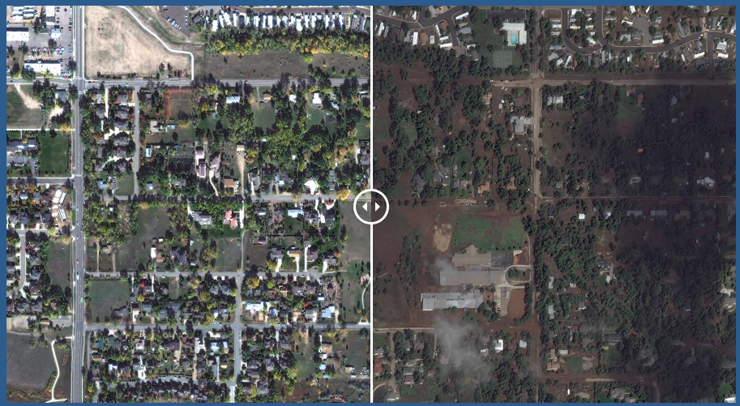
Case Study: 2013 Colorado Storm
What causes precipitation? Can our model help us explain the Colorado storm?
  Video Link Photos link
Notes:
Return to the Anchoring Phenomenon.
In small groups, prompt students to discuss what they now know about causes of precipitation and potential for precipitation. Have students share their thinking about the Anchoring Phenomenon and whether they believe the isolated storm model is consistent with the Colorado rain event. Discuss how the Colorado storm may or may not fit the Model Ideas. Note that students might also recognize that the length of the storm, which persisted for several days, does not fit the Consensus Model for an Isolated Storm.
Model Ideas from Learning Sequence 1:
Evaporation of water at the surface is important for clouds/storms.
Evaporation happens because of heating from sunlight.
Clouds form when water condenses.
The surface is warmer than the air above it.
The air near the ground is warmer than air closer to where clouds form.
Rising temperature and humidity are good conditions for an isolated storm.
Rising temperature and low humidity are not good conditions for an isolated storm.
A source of moisture is important to get water into the atmosphere for storms.
Warm air rises and cooler air sinks.
Warm air holds more water vapor compared to cool air.
Motivate a reason to test their model.
Explain to students that it is important to test a model to make sure it is useful for figuring out a phenomenon and can become helpful for making predictions. If they can figure out the best conditions for strong storms with heavy precipitation compared to conditions for weaker or smaller storms with less precipitation, their model will do a better job explaining why certain storms bring more precipitation compared to other storms.

Slide 57
Predict
Step 1: Make predictions.
Use your model for an isolated storm, and what you know about temperature and humidity, to predict the very best conditions that would lead to an isolated storm.
Notes:
Lesson 6: Step 1 of the Student Activity Sheet
Introduce the Make a Thunderstorm simulation.
Direct students to the Lesson 6: Student Activity Sheet. Introduce students to the Make a Thunderstorm simulation, which allows students to manipulate the temperature and humidity parts in their model to see how changing parts of the model affect storm potential. Emphasize to students that if one variable in their model changes, the outcome changes. They will need to explain why a strong storm forms, and also why weaker storms form, based on the changes they made to parts of the model.
Use the Consensus Model to make predictions.
Have students use their Consensus Model to make predictions about the best conditions for storms. Students record their predictions in Step 1 on their handouts.

Slide 58
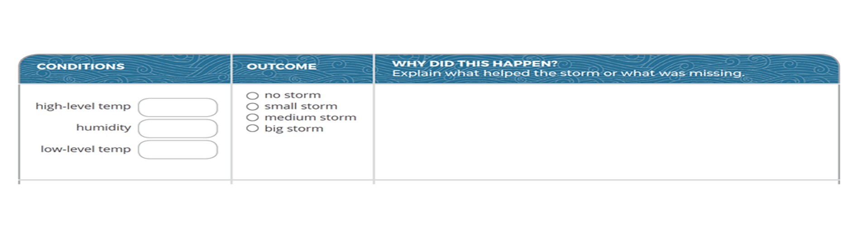
Investigation: Make a Thunderstorm
Step 2: Collect data from the simulation and record your observations and explanations in the data table.
    Simulation: https://scied.ucar.edu/make-thunderstorm
Notes:
Lesson 6: Step 2 of the Student Activity Sheet
Collect evidence from the simulation.
Arrange students in groups with a computer or tablet. Orient students to the simulation and give students instructions for recording data on their handouts. Students collect data from the simulation. Walk around and monitor progress. Prompt students to explain the storm outcome in terms of conditions that helped a storm form and conditions that did not help a storm form.
Important patterns to identify from the simulation:
Warm temperatures near the surface and colder temperatures higher in the atmosphere with high humidity are ideal conditions for thunderstorms.
If there is less of a temperature difference between the two altitudes, weaker storms may still form.
If there is low humidity, regardless of temperature, thunderstorms will not form.

Slide 59
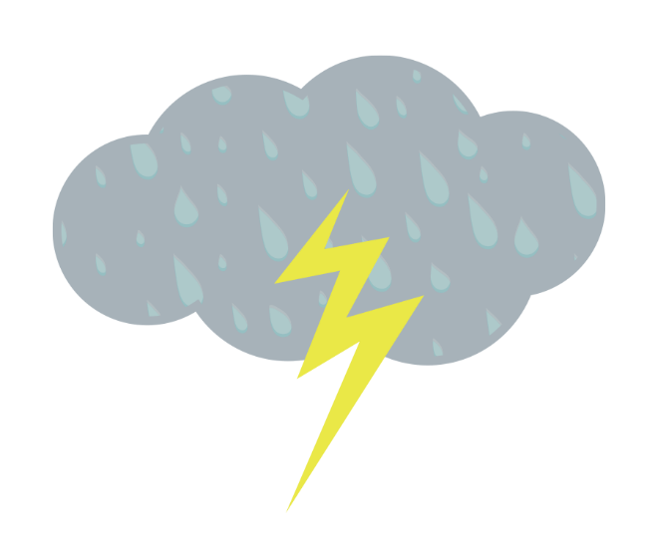
Making sense
What parts of our Consensus Model for an Isolated Storm do we want to confirm or revise?
Notes:
Confirm and/or refine the Consensus Model.
As a whole group, return to the Consensus Model to confirm or refine the model. Prompt students to use data from the simulation to support whether they confirm or want to change part of the model.

Slide 60
Looking back
What happens leading up to a storm?
Notes:
Navigate from the previous activity.
Students understand how to use temperature and humidity data to make sense of storm potential in convective storms, specifically isolated storms. Students will use what they know to identify a rain event and to construct an explanation about what happened leading up to this event. Use the Model Idea Tracker to provide students with guidance to help them pull together what they know to make a claim about when this type of rainstorm happens:
If the air near the Earth’s surface needs to be warm and rise for a storm to form, and the Sun heats the ground surface, which heats the air near the ground, then at what time of day would you expect a thunderstorm?

Slide 61
Investigation: Data from Pompano, Florida
Can our model help us determine when a rain event occurred?
Step 3: Analyze the data.
  When did it rain in Pompano, Florida? Circle on the graph.
  Explain what conditions were likely leading up to this rain event and why you think the rain happened at this time?
Notes:
Lesson 6: Step 3 of the Student Activity Sheet
Orient students to the new data set. Direct students to Lesson 6: Step 3 on their activity sheets. Students examine historical temperature and humidity data to test whether their isolated storm models help them determine when a rain event occurred in Pompano, Florida.
Pompano data set:
This data set comes from Pompano Beach High School (a GLOBE school partner) in Pompano, Florida. The temperature and (relative) humidity data on July 21 and July 22, 2017, comes from a WeatherBug automated weather station co-located with this GLOBE school. These automated stations record weather data daily every 15 minutes. This data can be found on the GLOBE Visualization Tool and the GLOBE Advanced Data Access Tool.
Analyze the data.
Allow students time to work individually or in groups to analyze the data and determine the time of the rain event. If students disagree, they should use evidence to argue for their choices.

Slide 62

Pompano, Florida rain event
When did it rain?
  The rain began at 12:45 p.m. on July 21.
How do we know?
  The graph shows a significant increase in humidity and a significant decrease in temperature at that time..
Notes:
Share the precipitation data with students. Project the precipitation data so that students can see if they were correct in their identifications. Through a whole class discussion, prompt students to explain whether their decisions were correct or incorrect and to share.

Slide 63
Driving Question Board
What questions can we now answer? What new questions should we add?
Notes:
Provide time for students to update the Driving Question Board.
Ask students to return to the board to answer questions, make changes to questions, and/or add new questions. Have students share aloud the new answers they have and/or new questions they want to add.

Slide 64
Case Study: 2013 Colorado Storm
Did the Colorado storm happen in the afternoon?
What parts of our model might explain the Colorado storm?
  Video Link Photos link
Notes:
Return to the Anchoring Phenomenon again. Ask students: “Did the Colorado storm happen in the afternoon?” Students might remember that the video revealed that the storm lasted several days. Ask students what parts of their models might explain the event and what they think could be different. Since the Colorado event lasted much longer than the typical isolated storm, something else might be going on in that type of storm. Use this to initiate further investigations into different kinds of storms that students will explore in Learning Sequence 2.
For example:
“Our model helps us explain some kinds of storms, but the storm in Colorado lasted a lot longer. The Colorado storm might be a different kind of storm, so we need to do some more investigating to figure it out.”
Emphasize the power and limitation of models. Have students talk about the kinds of storms that their models explain well, but also the types of storms that do not fit their models. Explain to students that models are tools to help us explain things happening in the world but that they are not always perfect and cannot capture everything. This is especially true for models of complex systems like weather, which is why weather is predicted probabilistically.

